Slide 1


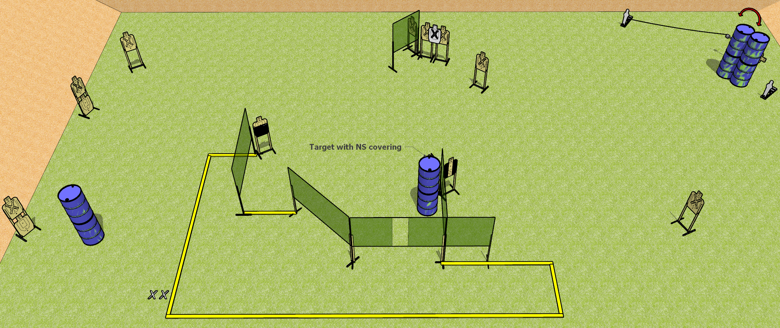
 | Dothan Gun Club – USPSA Match Steps Course Designer : Drew Coleman
START POSITION : Standing with both feet on X’s, wrists above shoulders
GUN READY CONDITION : Pistol unloaded and holstered. PCC unloaded, held with both hands, stock on belt. |  | SCORING: Comstock, 30 rounds TARGETS: 14 paper, 2 Steel SCORED HITS: Best 2 on paper, steel until down START-STOP: Audible, last shot RULES:
STAGE PROCEDURE: Engage targets as they become available from within the fault lines.

Slide 2
Steps
Written Stage Briefing
Steps is a 30 round, 150 point, Comstock field course. There are fourteen USPSA targets and two mini poppers. The best two hits on paper will score. Steel must fall to score. The start signal is audible.
Handgun start position is standing with both feet on X’s, wrists above shoulders. Handgun is unloaded and holstered.
PCC start position is standing with both feet on X’s. Unloaded carbine is held with both hands, buttstock on belt.
On start signal, engage targets as they become available from within the shooting area.

